Slide 1
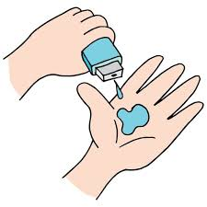
Project Title - Blockchain-Based Land Registry System
Ayush Shukla

Slide 2

PROBLEM STATEMENT
Challenges in Traditional Land Registry:
Fraud and forgery in land records
Lack of transparency due to centralization
Lengthy, costly, and bureaucratic processes
Solution:
A blockchain-based smart contract system for secure, decentralized, and tamper-proof land records.

Slide 3
Project Description Objective: Develop a secure, transparent, and decentralized land registry system using blockchain. How It Works: Landowners register properties on a blockchain ledger. Buyers verify ownership using a tamper-proof decentralized system. Smart contracts automate secure land transfers. IPFS integration stores land documents in a decentralized manner

Slide 4

WHO ARE THE END USERS?
Government Agencies – To verify and regulate land ownership.
Landowners – For secure and transparent property registration.
Buyers & Sellers – To ensure fraud-free transactions.
Real Estate Companies – To maintain immutable property records.

Slide 5

Technology Used
Blockchain: Ethereum (Decentralized ledger for land records).
Smart Contracts: Solidity (Automated transactions & ownership transfer).
Backend: Node.js & Express.js (Handles API interactions).
Frontend: React.js (User interface for registration & transfer).
Storage: IPFS (For secure and decentralized document storage).
Wallet: MetaMask (For secure transactions & authentication).

Slide 6
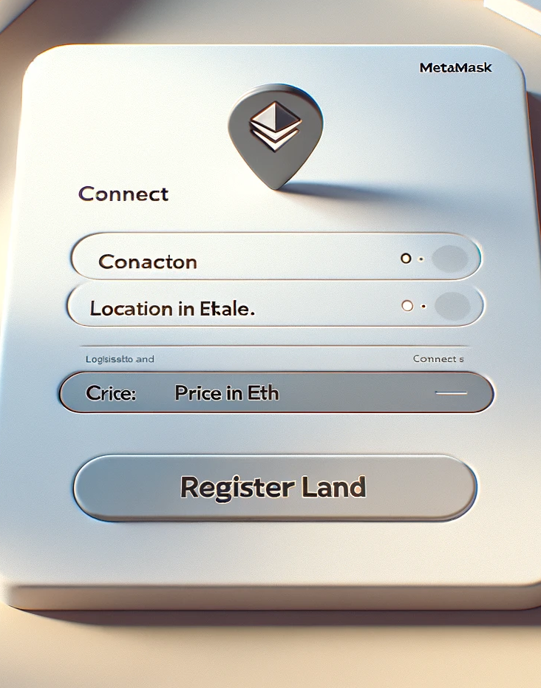
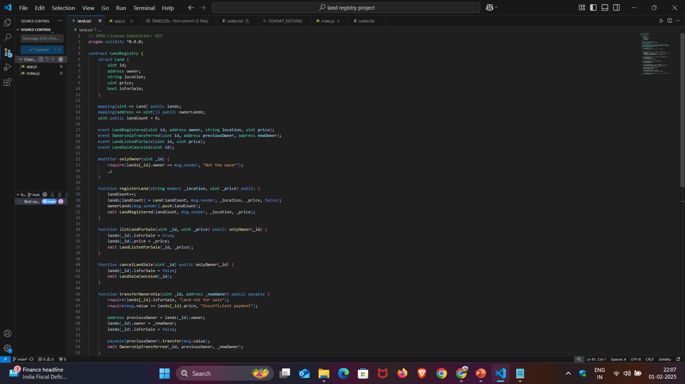
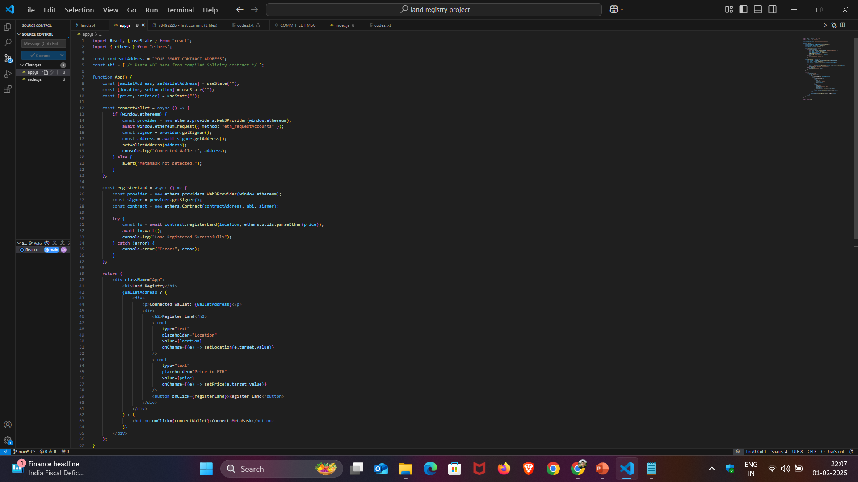
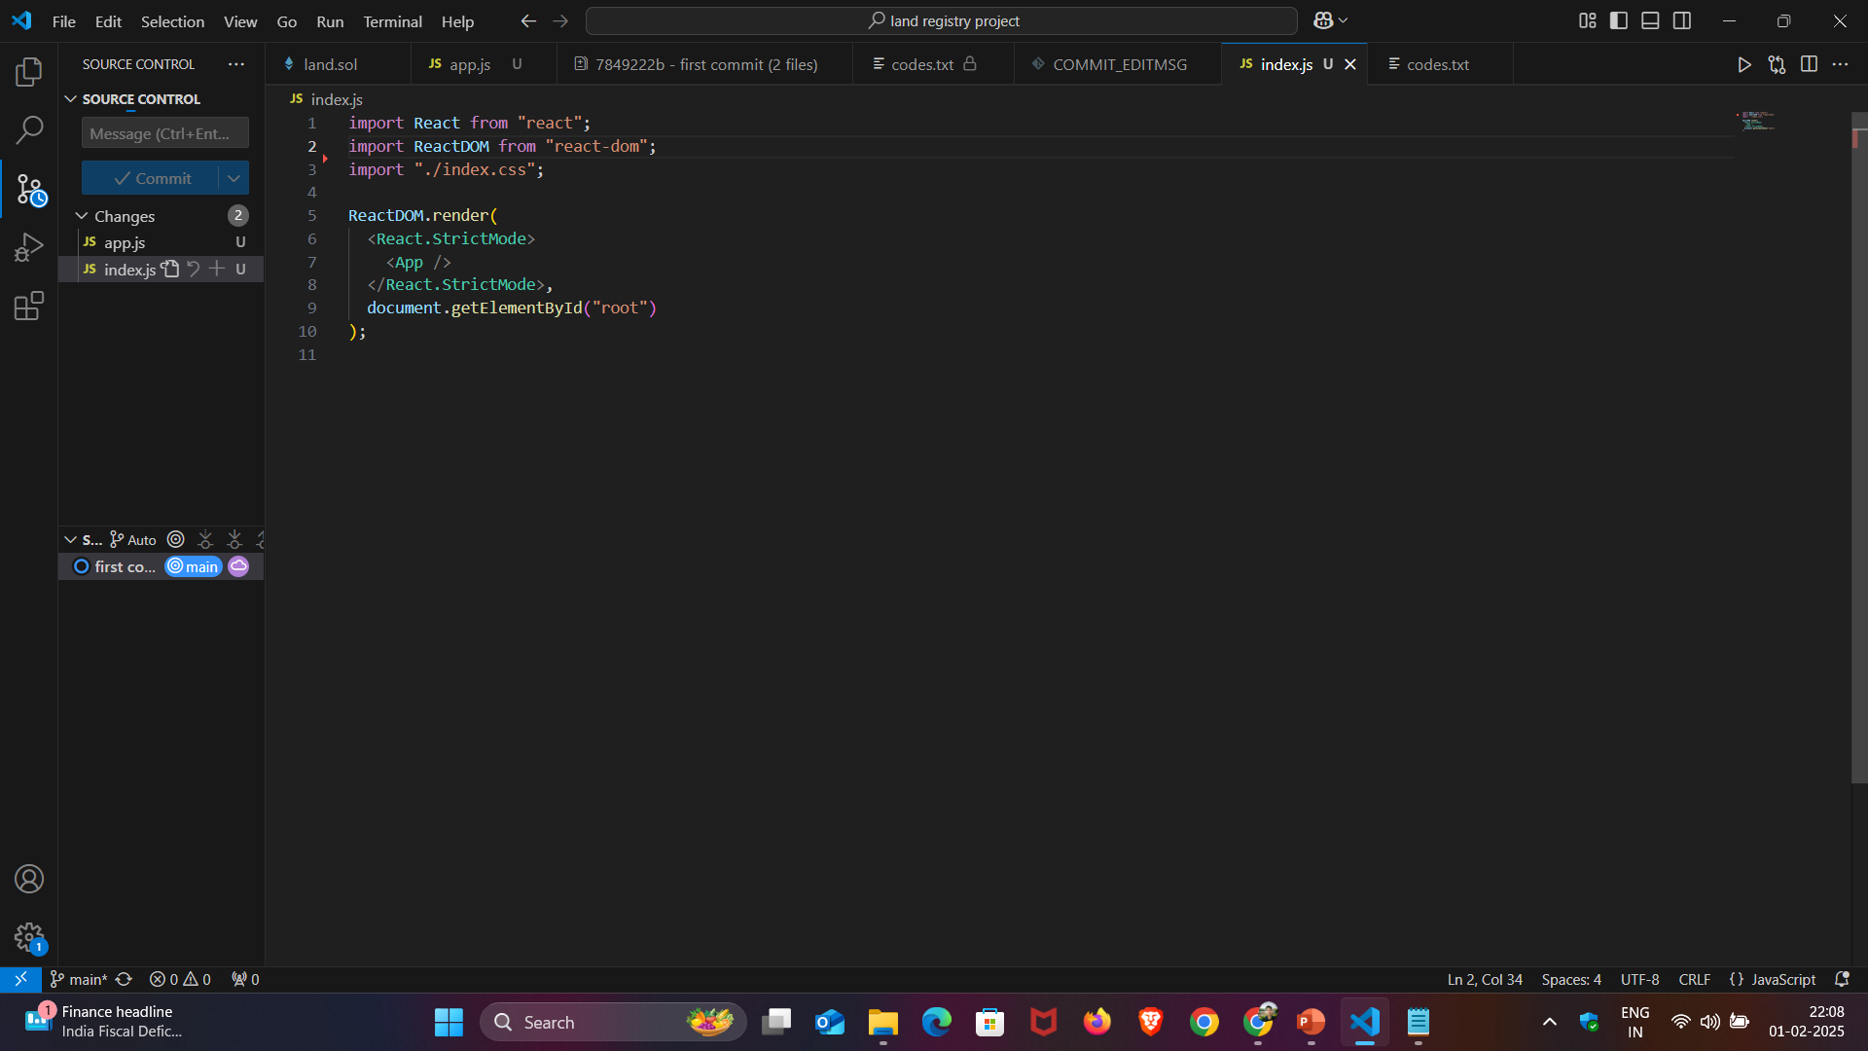
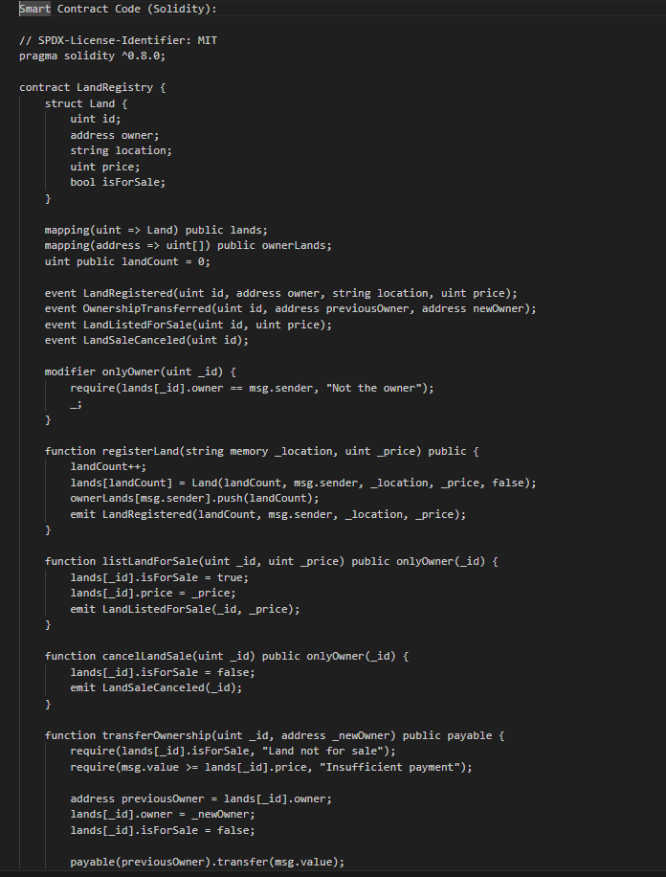
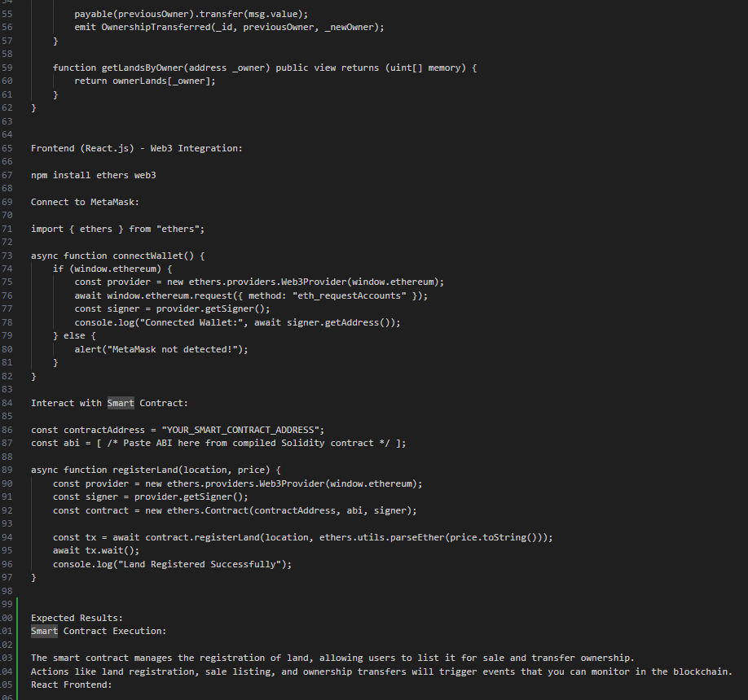
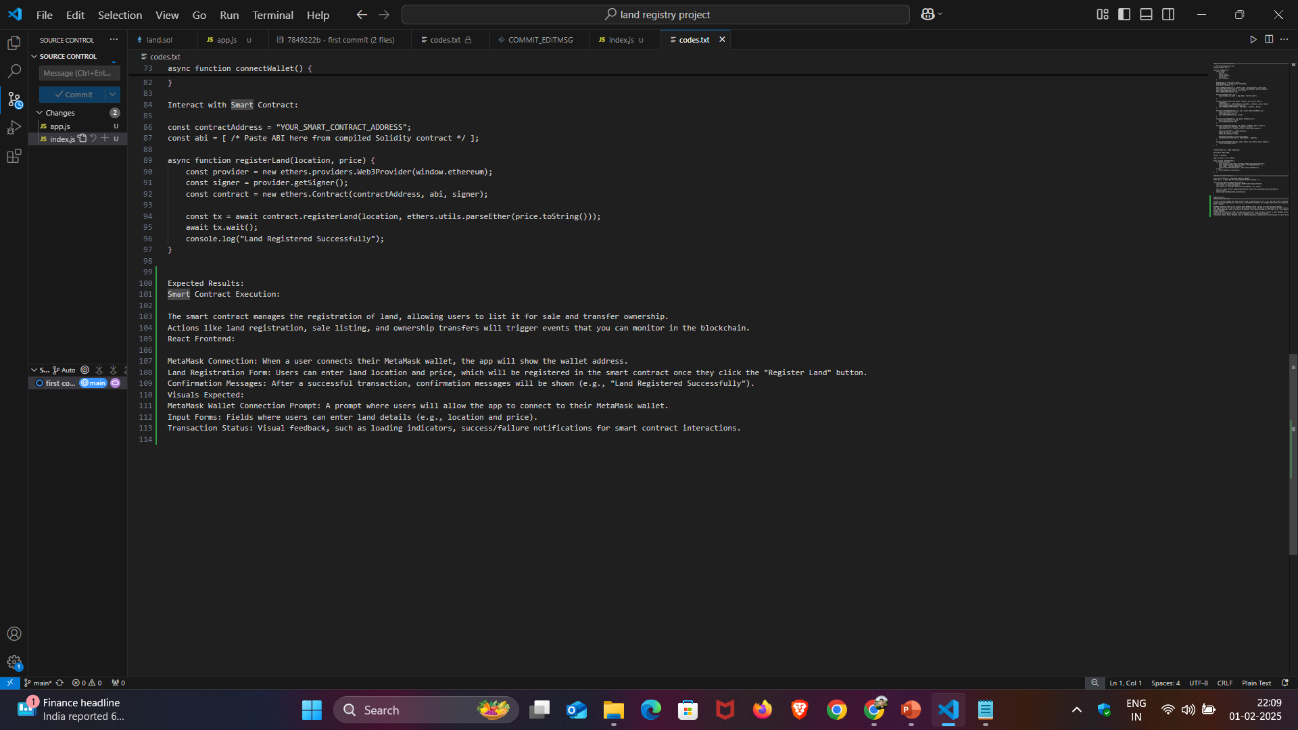
RESULTS
https://github.com/ayushshukla-01/land-registry-project.git

Slide 7
Thank you
By this project I learned many things which will give me help in future and I had a great experience
.
.

